Slide 1
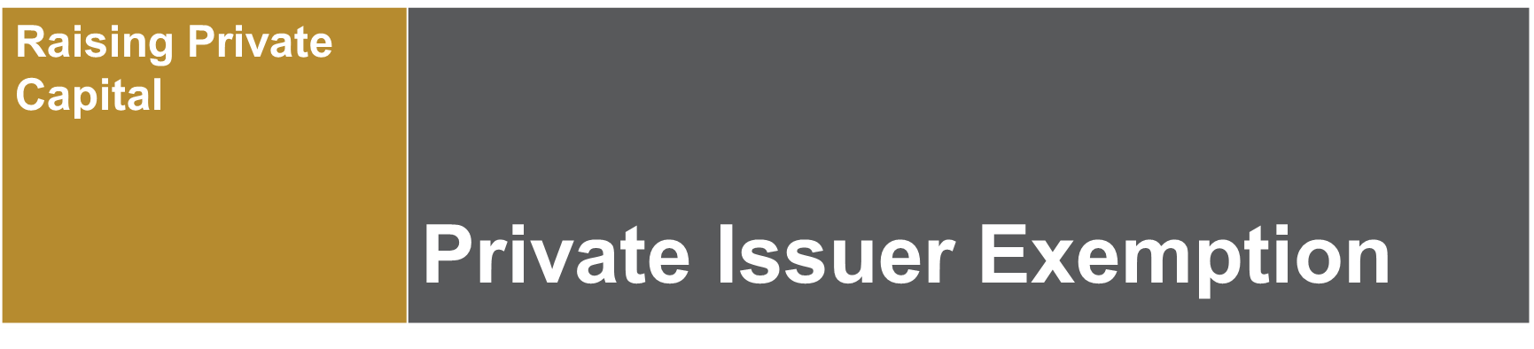


This video provides only general introductory information. Please don’t rely on it as legal advice!
Refer to the specific provisions of Alberta securities laws and/or engage qualified legal counsel.
Click on the speaker
to hear the audio

Slide 2

Common Capital Raising Exemptions
We suggest watching the introductory video in this series “Raising Private Capital – Navigating Securities Laws” for small business prior to watching this video
Some of most commonly relied upon prospectus exemptions used by small businesses to raise capital are:
Accredited investor exemption
Private issuer exemption
Family, close personal friends and close business associates exemption
Offering memorandum exemption
Crowdfunding options
Notes:
Speaking Notes:
There are a number of prospectus exemptions that can be relied on by businesses to raise capital.
The more common exemptions relied upon by small business are listed on this slide.
This video focusses on one such exemption – the family, friends and business associates exemption. For further details on the other exemptions noted on this slide, feel free to watch one of the other videos in this series and refer to our website content.

Slide 3


Introduction to the Private Issuer Exemption
Used by businesses when they are just starting up e.g.,
  Organizing business – issuing founders’ shares
  Seed stage investment e.g., from family & close friends
  Business may even have relied on it without realizing
Many small businesses will only ever use this exemption
Harmonized: s. 2.4 of National Instrument 45-106 Prospectus Exemptions
No prescribed offering document
No prescribed risk acknowledgement form
No filings with or reporting to securities regulators
Combination
  accredited investor
  family, friends & business associates
  Employees
  + more

Slide 4
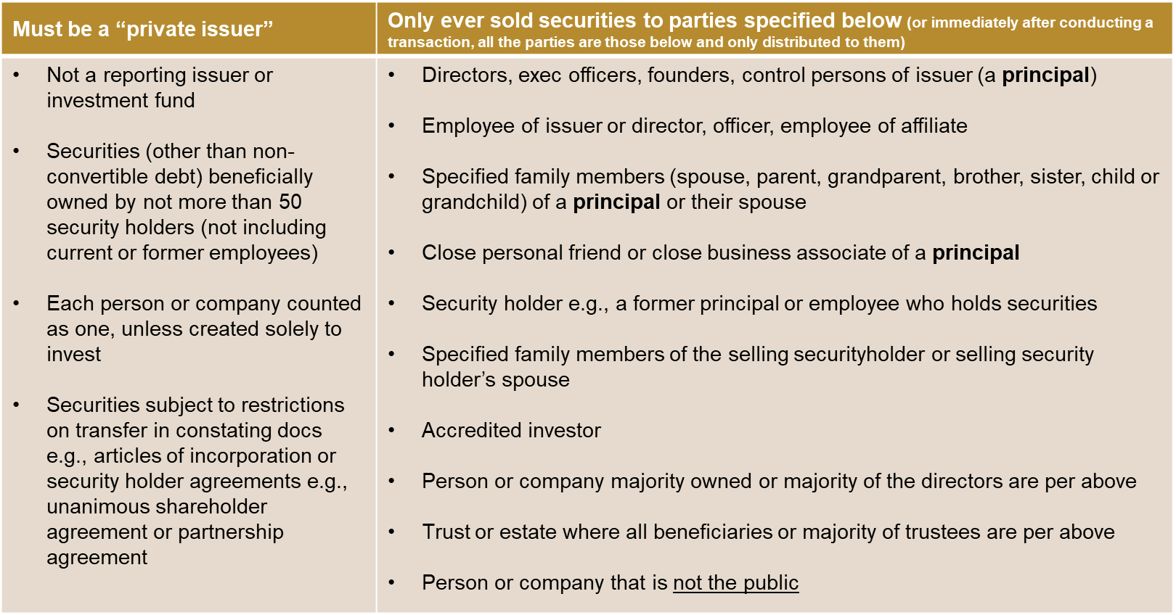


Two Principal Requirements

Slide 5

Key terms
Founder – took the initiative in founding, organizing or substantially reorganizing business and still actively involved in the business
Director – for non-corporate issuers, includes those performing similar functions to a director
Executive officer –
  Chair, vice-chair, president, CEO, CFO (regardless of title) VP in charge of principal unit/division
  Policy-making function i.e., responsible (jt.) for setting the direction of the issuer and sufficiently knowledgeable about issuer to respond meaningfully to investor inquiries
Control person
  sufficient # of voting securities to affect materially control of issuer &
  by self or with others, with whom acting in concert under agreement, understanding, etc. holds sufficient # of voting securities to affect materially control
  in absence of evidence to the contrary if holds >20% voting securities, deemed control

Slide 6


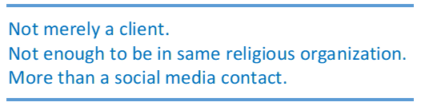
Key terms continued
Close personal friend – direct relationship with a principal (not friend of a friend)
  well enough and
  long enough
  to be able to assess their capabilities and trustworthiness and to obtain information from them on the investment
Close business associate - someone who has had sufficient prior business dealings with a principal of the issuer, to be able to
  assess that person's capabilities and trustworthiness and
  obtain information on the investment

Slide 7

Key terms continued
Accredited investor
Individuals | Institutions and companies
Registered as a representative of a registered dealer or adviser | Financial institutions, pension funds, trust corporations
Net realizable financial assets (cash & liquid securities) >$1 million (alone or with spouse) | Governments, municipalities, crown corporations
Net income >$200K for each of last 2 years and expected to continue | Investment funds that have distributed under a prospectus or only distributed to accredited investors
Net income with spouse >$300K for each of last 2 years and expected to continue | Entities owned entirely by accredited investors
Net assets (all assets) of >$5 million alone or with spouse | Companies with net assets >$5 million

Slide 8

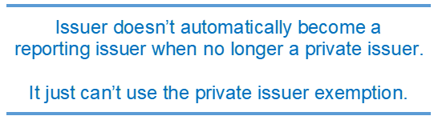
Some final take-aways
Must comply with law in each applicable jurisdiction where
there is a “distribution”
Resale restrictions continue indefinitely for security holders of
non-reporting issuers, until issuer becomes a reporting issuer
  Resell only under a prospectus or another prospectus exemption
Obligation (and risk) is on the sellers to make sure
exemption available and comply with all conditions.
Confirm investor’s status, e.g., accredited investor or close business associate
  Don’t rely just on written representation
  Keep records
  Ensure those selling understands rules

Slide 9
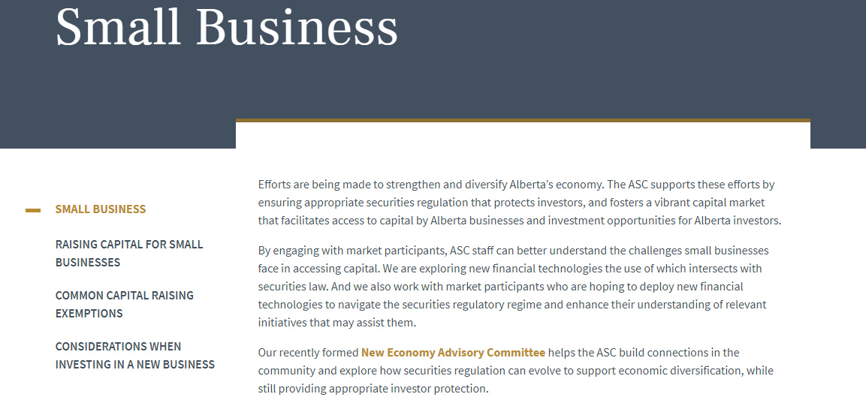
Still have questions?
See ASC website

