Slide 1
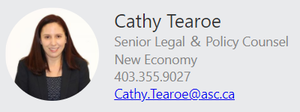
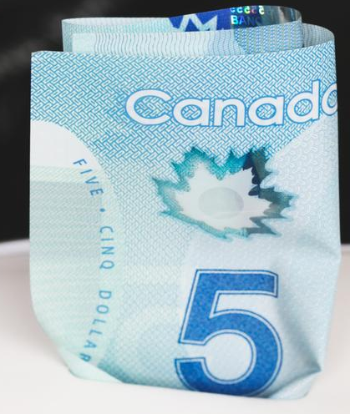

Raising capital for private businesses
 | Family, Friends and Business Associates Exemption This video provides only general introductory information. Please don’t rely on it as legal advice! Refer to the specific provisions of Alberta securities laws and/or engage qualified legal counsel.

Slide 2
Common Capital Raising Exemptions
We recommend watching the introductory video in this series “Introduction to navigating securities laws for small business” prior to watching this video
Some of most commonly relied upon prospectus exemptions by small businesses for capital raising are:
Accredited investor exemption
Private issuer exemption
Family, close personal friends and close business associates exemption
Offering memorandum exemption
Crowdfunding options

Slide 3

Family, Friends and Business Associates Exemption
S. 2.5 of National Instrument 45-106
Prospectus Exemptions
Director, executive officer, control person or founder
of the issuer or one of its affiliates
  control person = typically a holder of 20% of the voting securities
  founder = actively involved in the business of the issuer at the time of distribution
Or persons or companies that have one of the following relationships with one of those principals:
  a specified family member
  close personal friend
  close business associate

Slide 4

Relationship Requirement
Specified family member:
  spouse
  parent, grandparent
  brother, sister
  child or grandchild
Close personal friend - individual who knows the principal well enough and has known them for long enough to be able to assess their capabilities and trustworthiness and to obtain information from them on the investment
Close business associate - someone who has had sufficient prior business dealings with a principal of the issuer, to be able to assess that person's capabilities and trustworthiness
Entity majority owned or majority trustees/executors by those above

Slide 5

Relationship Requirement – cntd.
To be considered “close” it is not enough merely to:
  belong to the same religious organization
  be part of the same club or group of a co-worker or client
  be a client or customer
  have a social media connection
  Must be a relationship of trust and both parties should believe that such a relationship exists

Slide 6
Confirming Relationship
Should not rely solely on any representations made by investor to verify the relationship
  establish policies and procedures that apply to all parties acting on behalf of the issuer (i.e., employees, officers, directors, agents, finders or intermediaries) to confirm their understanding of the exemptions being relied upon
  ask questions designed to confirm the nature and length of the relationship
  keep all relevant documentation and consider whether you should have the purchaser sign the documentation
No “bright line” test to determine whether an applicable relationship exists

Slide 7
Restrictions and Filing Requirements
Commissions/finder’s fees cannot be paid to directors, executive officers, founders or control persons
No prescribed offering document.
Voluntary offering document not required to be filed with ASC. Can’t be misleading or fraudulent.
Must file a report of exempt distribution (Form 45-106F1) + fee within 10 days of each distribution and pay fee
In SK and ON, a prescribed risk acknowledgement required

Slide 8

Tips and Traps
Obligation (and risk) is on the sellers to make sure
exemption available and comply with all conditions.
Resale restrictions apply to purchasers
  4 months for security holders of reporting issuers
  But continue indefinitely for security holders of non-reporting issuers
  Resell only under a prospectus or another prospectus exemption during resale restrictions.
Must comply with law in each applicable
jurisdiction e.g., where there is a “distribution”
  Consider location of issuer & location of investor
  ON & BC – e-filing

Slide 9
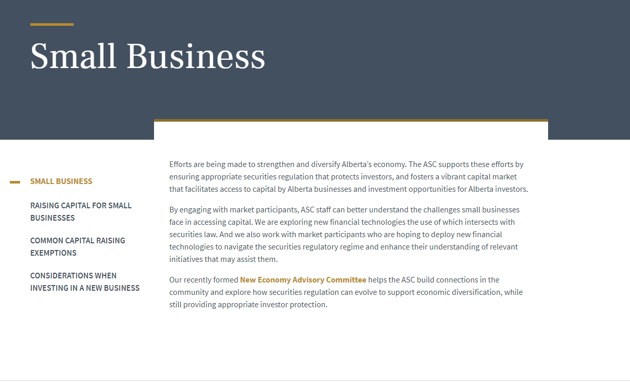
Need More Information?
See ASC website:
Send us a question: New.Economy@asc.ca

