Slide 1


This video provides only general introductory information. Please don’t rely on it as legal advice!
Refer to the specific provisions of Alberta securities laws and/or engage qualified legal counsel.
Click on the speaker
to hear the audio

Slide 2
Overview
Other presentations
Specifics of particular prospectus exemptions
But first…
  What is the ASC?
  How does securities law work across Canada?
  Where do I find Alberta securities laws?
  Key terms
  Fundamental requirements
  Prohibitions
  Final pointers

Slide 3
What is the ASC?
Alberta Crown corporation, regulatory agency, administrative tribunal
Mission = to foster a fair and efficient capital market & protect investors
Administer securities laws
Make Rules & Guidance
Review Disclosure
Provide exemptions
Compliance & Enforcement
Oversees exchanges, SROs
Register & oversee dealers & advisers

Slide 4

Securities regulation in Canada
Constitutional division of powers: provincial jurisdiction
Each jurisdiction has its own statute and regulatory authority
But through the Canadian Securities Administrators (CSA)
  - Laws harmonized
                - Administration coordinated
  - Discretionary decision-making
  streamlined through passport system
Stock exchanges & SROs have supplementary rules
Most securities rules are identical across the country. But…most differences are in prospectus exemptions.

Slide 5
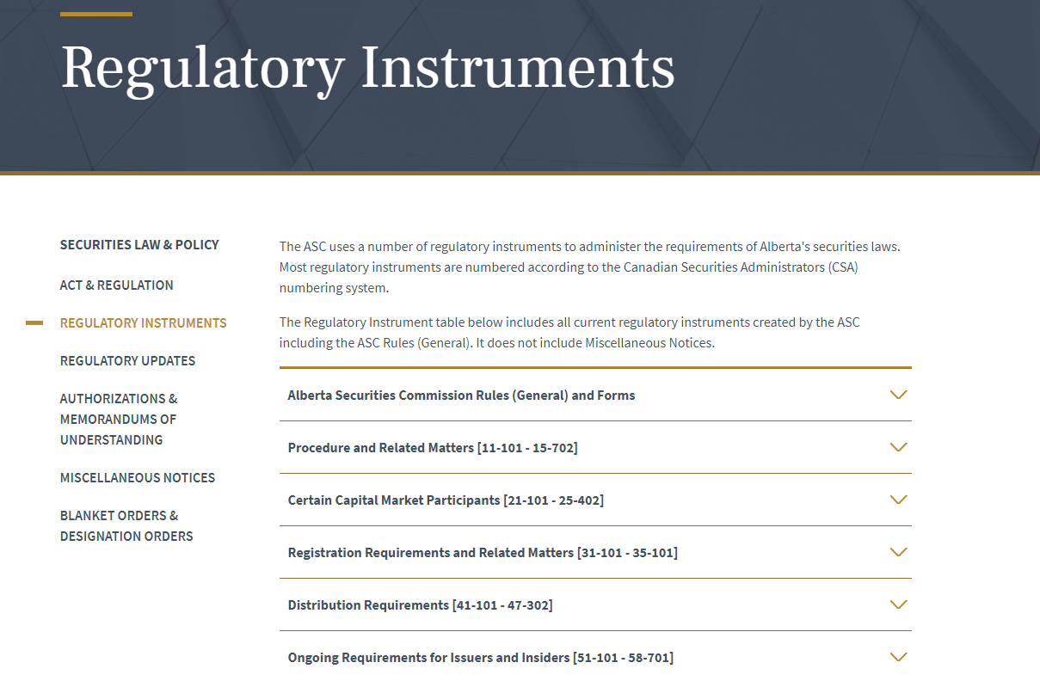
Where do I find Alberta securities laws?
ASC website: https://www.albertasecurities.com/securities-law-and-policy

Slide 6


Key Term
“Security” broad definition. Much more than just shares
  Includes bonds, debentures, notes or other evidence of indebtedness
  Evidence of title, to or interest in the capital, assets, property, profits, earnings or royalties of any person or company
  Any document constituting evidence of an option, subscription or other interest in a security
  Investment contracts (e.g., expectation of profit from effort of others)
  And more…

Slide 7

More key terms
“Issuer” = a “person” or a “company”
  that has outstanding securities, is issuing
  securities or proposes to issue securities
  Could be private or public
“Reporting issuer” generally means issuer has obtained a receipt for prospectus, but can also become reporting
  by an amalgamation or arrangement with a reporting issuer,
  listing on a recognized exchange in the jurisdiction, or
  designation e.g., MI 51-105 Issuers Quoted in the U.S. Over-the-Counter Markets
Reporting issuers are required to provide ongoing disclosure, allowing informed investment decision making in secondary market
“Public company” & “private company” colloquial terms

Slide 8
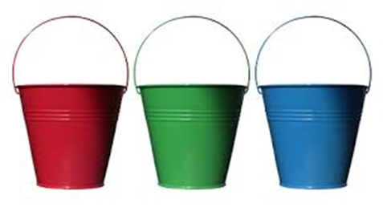
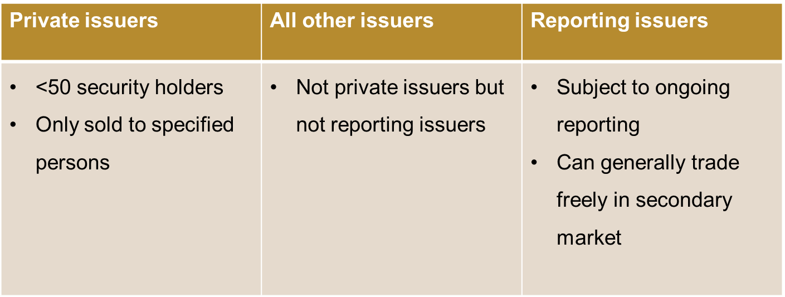
Types of issuers: private, reporting and other

Slide 9
And two more key terms: Trade and Distribution
“Trade” – includes the sale or disposition for valuable consideration but also includes any act, advertisement, conduct or negotiation in furtherance of a trade
“Distribution”
a trade in previously unissued securities (e.g., a financing)
a person or company trades/resells securities acquired under a prospectus exemption i.e., before expiry of resale restrictions)
a “control person” (e.g., >20% holder) sells securities

Slide 10

Two Key Pillars: Prospectus Requirement (s.110 Act)
& Registration Requirement (s.75 Act)
Prospectus requirement – need to file a prospectus and get a receipt for a trade in a security that would be a “distribution”
Prospectus = offering/disclosure document
  Full, true & plain disclosure of all material facts
  Comply with form requirements
  Include prescribed financial statements
Registration requirement
  If in “the business” of trading or advising in securities (or holding self out as such) must be registered
  Registration is a licensing requirement + ongoing obligations
  (Registration also required for investment fund managers)

Slide 11
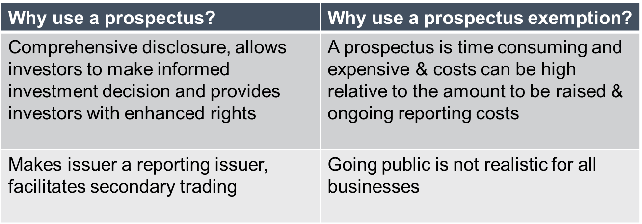
Prospectus or prospectus exemption?
Need prospectus or prospectus exemption if a “distribution”
Prospectus exemptions provide an alternative
Attempt to balance investor protection & economic efficiency.

Slide 12

Rationale for prospectus exemptions
Theory: Don’t need prospectus if investors
    rich enough to withstand the loss
    relationship of trust with principal of company
    prospectus-like disclosure otherwise available
Reality: Exemptions narrow and technical
  There isn’t a codified exemption for every situation
  Obligation on issuer/seller to comply
So… what if can’t fit in one of the codified exemptions?
Application for discretionary relief can be made

Slide 13
Where are the codified prospectus exemptions?
Most exemptions located in one rule:
National Instrument 45-106 Prospectus Exemptions
(NI 45-106)
  Rule adopted in all jurisdictions
  In force since September 14, 2005
  Some differences in some exemptions between jurisdictions
See also additional local ASC rules, e.g.,
  ASC Rule 45-511 Local Exemptions and Related Requirements
  ASC Rule 45-517 Prospectus Exemption for Start-Up Businesses
  ASC Blanket Order 45-521 Start-Up Crowdfunding Registration and Prospectus Exemptions
  ASC Rule 72-501 Distributions to Purchasers Outside Alberta

Slide 14

Things not to do: Prohibitions: ss. 92 & 93 of the Act
Fraud, misleading or untrue statements and omissions
Unfair practices
  Unreasonable pressure
  Taking advantage of inability or incapacity
  Harsh, oppressive or excessively one-sided terms
Representing you will
  trade at the market price (or related price)
  refund, resell or repurchase a security (unless part of terms of security)
  get listed on an exchange w/o Exec Dir consent or exchange approval
Undertaking re future value or price
False or misleading appearance of trading or creating an artificial price

Slide 15
Some final pointers
Prospectus exemption is NOT:
  An exemption from the registration requirements
  An exemption from statutory prohibitions e.g., misleading statements or unfair practices
Obligation to comply is on the seller/issuer
Securities acquired under prospectus exemptions typically subject to resale restrictions – limited ability to resell
Selling securities under prospectus exemptions generally triggers a requirement to file a short report on the sale
Need to comply with the laws of each jurisdiction in which there is a “distribution”

Slide 16
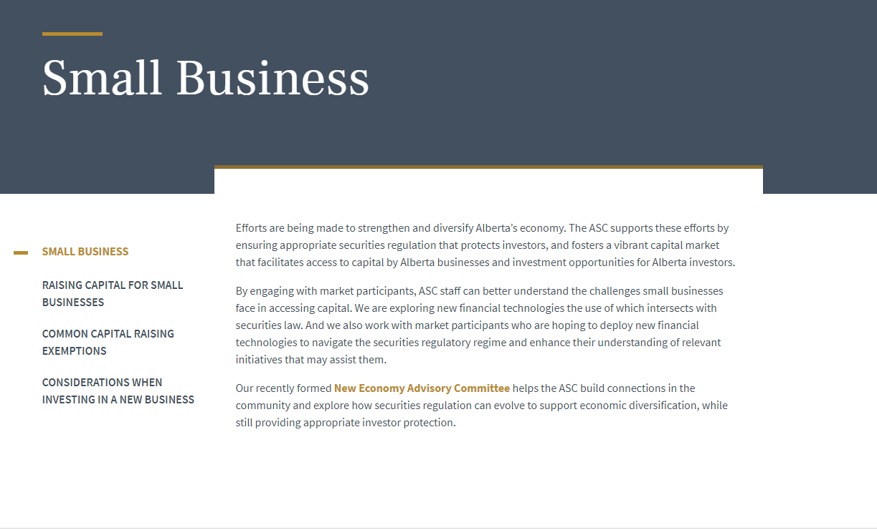
Need more information?
See ASC website:
Send us a question: New.Economy@asc.ca

